Slide 1
Membership Inference Attacks Against Machine Learning Models
2017, Cornel Tech, IEEE S&P, 3000+

Slide 2

Abstract
Classification task
NN model
Cat
Dog
Cow
.
.
.
Data

Slide 3
Abstract
NN model
Cat
Dog
Cow
.
.
.
NN model
In
out
Data
Data
<Target model>
<Attack model>

Slide 4
Abstract
“Membership Inference attack”
NN model
In
out
Data
<attack model>
Observe that model behaves differently on the data it has been trained and on the data it has never seen.

Slide 5
Abstract
“Membership Inference attack”
NN model
In
out
Data
<attack model>
In privacy perspective, sensitive information such as hospital discharges may be leaked.

Slide 6
Abstract
Key idea.
NN model
In
out
Data
<attack model>
Introduce shadow training technique to train attack model

Slide 7
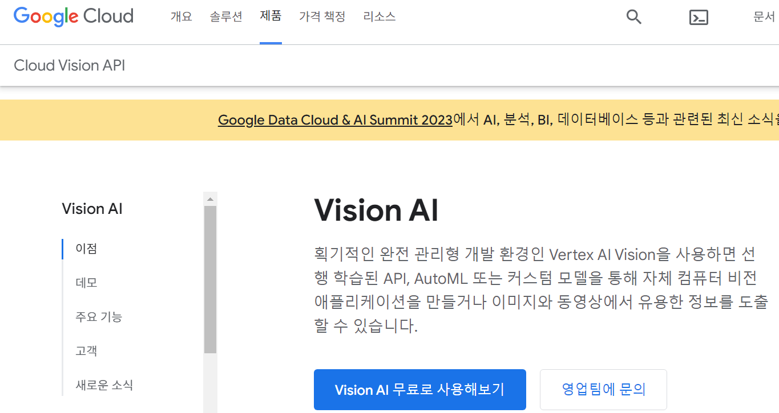

Background
“Machine learning as a service”
- Provide API (upload data, prediction etc.)
- API hides all details. (training algorithm, architecture, hyperparameter etc.)
Google
Amazon

Slide 8
Method
Assumption.
- Basic.
Attacker knows all information of input and output (type, class, range)
Attacker knows model architecture and training algorithm.
(number of layers / SVM / NN etc.)
or
Attacker knows machine learning oracle black box and can access to it.
[google api / Amazon api]

Slide 9
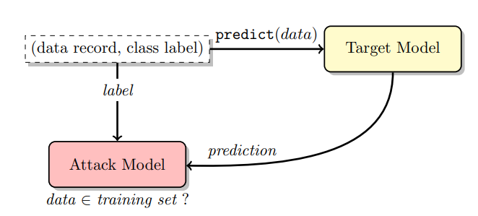
Method
Membership inference attack

Slide 10
Method : train attack model
Require data record, prediction, class label, (in/out)

Slide 11
Method : train attack model
[in/out] ?

Slide 12
Method : train attack model
Shadow model
[in / out]

Slide 13
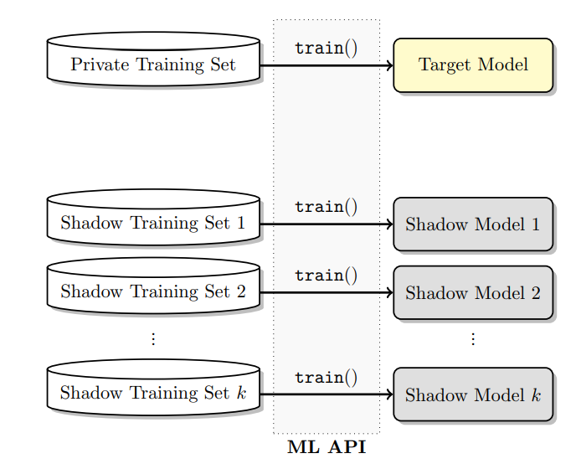
Method : shadow model
Similar to target model

Slide 14
Method : generate data & label
3 ways
1. model-based : use data with a high prediction score of the target model
2.
3.
Assume that attacker knows the population
distribution of target train dataset.

Slide 15
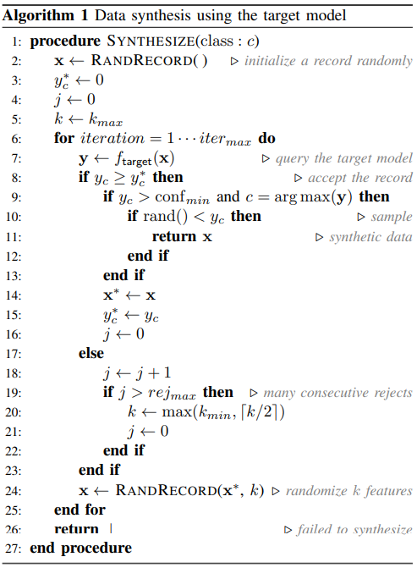
Method : algorithm
전체 class에 대한 prediction score : Y
Class c에 대한 prediction score : y_c
Class c에 대해서 내가 가지고 있는 가장 큰 prediction score : y_star
NN model
Cat -> 0.1
Dog -> 0.6
Cow -> 0.2
.
.
.
Class가 c인 data set을 만들겠다!
Data의 feature를 uniform하게 sampling 해서 x를 만든다
Data로 최종 결정이 되든 안되든, 내가 가지고 있는 y_star 보다 크니 신뢰성이 있는 data라고 판단하고 가져오기
적어도 conf_min보다는 크고 Y에서 y_c가 가장 큰 값이면 data로 더욱 고려하겠다.
0~1사이의 난수보다도 y_c가 크면 그때는 data로 최종 결정
현재 내가 가지고 있는 가장 큰 prediction score
원하는 만큼 반복
y_c가 내가 가진 가장 큰 prediction score보다 크면, data로 고려해본다.
X에 대한 target model의 prediction score Y 생성
Data
y_c < y_star 라면, 신뢰성이 떨어지는 sample이므로 data로
고려하지 않는다.
신뢰성이 있는 sample인 x_star에서 k 개만큼의 feature만 random하게 변경해서 새로운 sample 생성.
X_star의 feature를 k개만큼 바꾸면서 sample을 뽑았는데, 이 sample들이 계속 신뢰성이 없다고 판단되면 k를 바꿔서 색다르게 sampling한다.
<Target model>

Slide 16
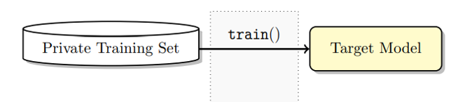
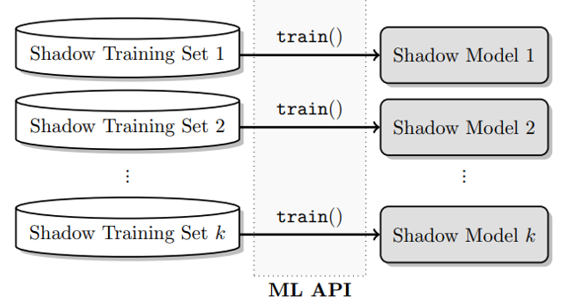
Method : generate data & label
similar
similar
Data record & label
Using same API

Slide 17
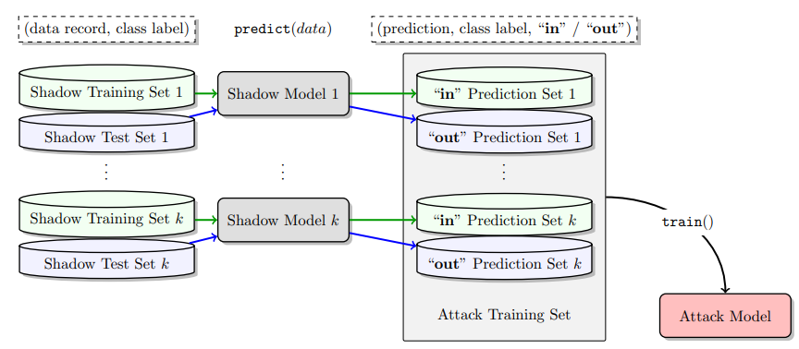
Method : train attack model

Slide 18
Method : generate data & label
High prediction score로 in/out을 판별하는 것이 아닌, train/test 사이의 미묘한 차이를 학습한다.

Slide 19
Method
Membership inference attack

Slide 20
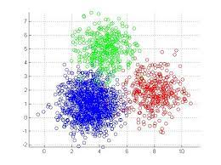
Method
number of class

Slide 21
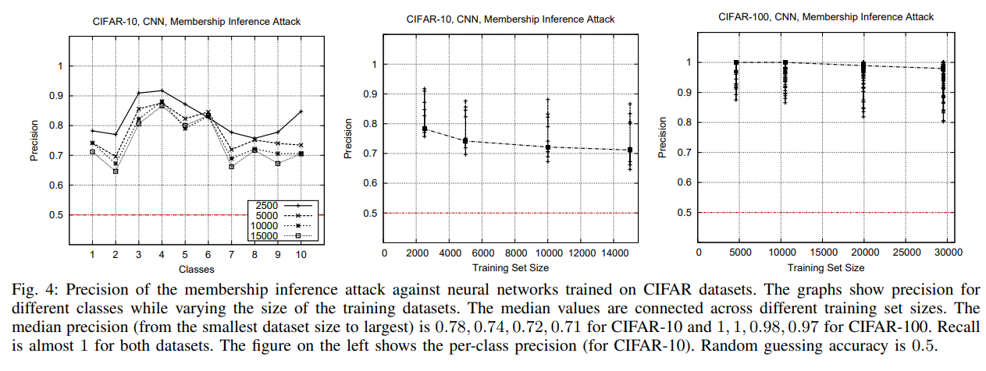
Experiment
Good performance
More classes -> more higher performance

Slide 22
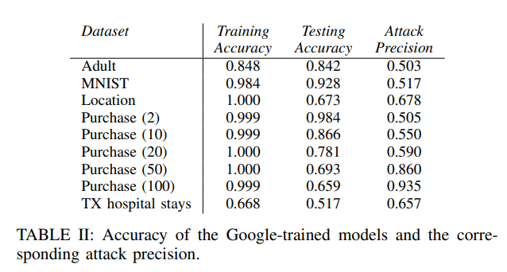
Experiment
More classes -> easy to overfit -> more higher performance

Slide 23
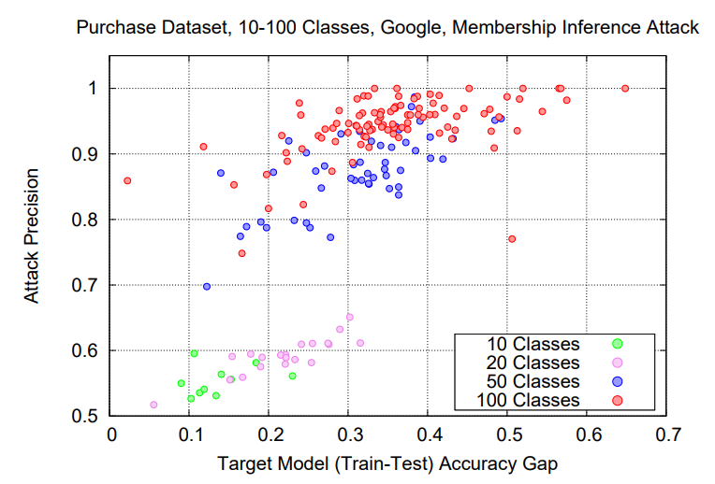
Experiment

